Slide 1
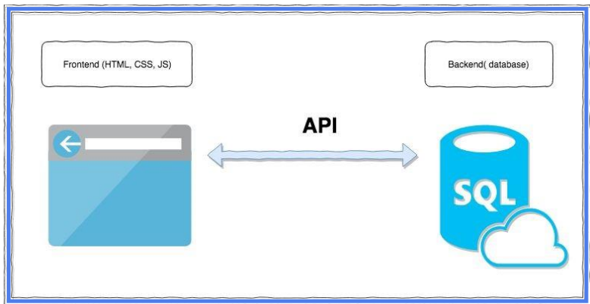
1. What is API?
API stands for the Application Programming Interface. It’s kind of intermediary that allows two applications to talk to each other.
APIs provide a set of rules, protocols, and tools that developers can use to access the functionality and data of another software system, service, or platform.
● APIs helps in structuring the requests and responses, making it possible for developers to integrate various services and functionalities into their own applications without having to build everything from scratch

Slide 2
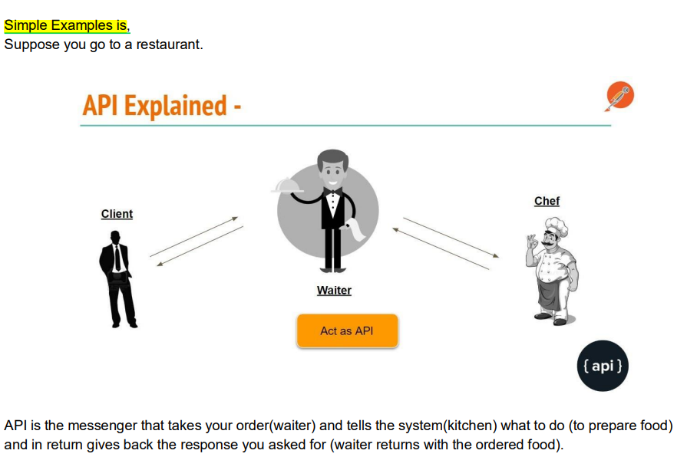

Slide 3
Types of API
SOAP API (Support XML Format)
REST API (Support JSON Format)
SOAP stands for Simple Object Access Protocol .
A SOAP API is an interface that allows applications to communicate with each other using SOAP protocol.
Soap is used for sending message between applications over various protocols , including HTTP, SMTP(Simple Mail Transfer Protocol), and more.
REST API stands for Representational State Transfer the resources are identified by unique URLs.
REST uses standard HTTP methods(GET , POST ,PUT ,DELETE , etc.) to perform actions on resources.
REST APIs are relatively simple to understand and use.

Slide 4
Difference Between SOAP API and REST API.
Feature | SOAP | REST
Full Form | Simple Object Acccess Protocol. | Representational State Transfer.
Purpose | SOAP is a Protocol for communication between application. | REST is an architecture style for designing communication interfaces.
Design | SOAP API exposes the operation. | REST API exposes the data
Protocol | SOAP is independent and can work with any transport protocol. | REST works only with HTTPS.
Data Format | Transports Data in Standard XML Format. | REST supports XML , JSON , plain test , HTML.
Performance | SOAP messages are larger which makes communication slower | REST has faster performance due to smaller messages and caching support.
Scalability | SOAP is difficult to scale. | Rest is easy to scale.

Slide 5
2. What is API Testing?
API Testing is a software testing type that validates Application Programming Interfaces (APIs).
The purpose of API Testing is to check the functionality, reliability, performance, and security of the programming interfaces.
APIs act as a bridge between different software systems, allowing them to communicate and exchange data with each other.
3. What to test in API Testing?
Validate the keys with the Minimum and Maximum range of APIs.
Have a test case to do XML, JSON Schema validation.
Keys verification .If we have JSON , XML APIs we should verify it’s that all the keys are coming.
Verify that how the APIs error codes handled.

